Slide 1
The Role of AI in DevOps
By Travis Frisinger
Notes:
Welcome, everyone. Imagine a world where our development and operational tasks are not just supported by technology but are fundamentally redefined by it. Today, we're embarking on an extraordinary journey into the heart of this new world, where Artificial Intelligence (AI) isn't just an auxiliary force but the main driver propelling DevOps into new realms of possibility.
Our exploration will unveil how AI is not merely a tool but a force, making our DevOps practices better, faster, stronger and safer. It's about harnessing AI to transform the very fabric of how we develop, deploy, and manage software, highlighting a significant paradigm shift in our industry.

Slide 2
The Broad Impact of AI on Work
Intersection of AI and DevOps
Culture and Support
Ops and Deployment
Testing and Security
Monitoring and Anomaly Detection
Navigating the Future
Agenda
Notes:
Our journey explores AI's role across industries, highlighting its impact on our daily lives. Then we'll delve into how AI and DevOps collaborate to make our work faster, better, stronger, and safer, transforming the way we monitor systems and identify issues. Looking ahead, we'll explore the future with ML Ops and LLM Ops, the new frontier in AI and DevOps integration. Our aim is to deeply understand AI's capability to improve our work. As we embark on this adventure, we're eager to uncover all the opportunities AI presents, ready to better understand the impact of this tech. Let's get started.

Slide 3
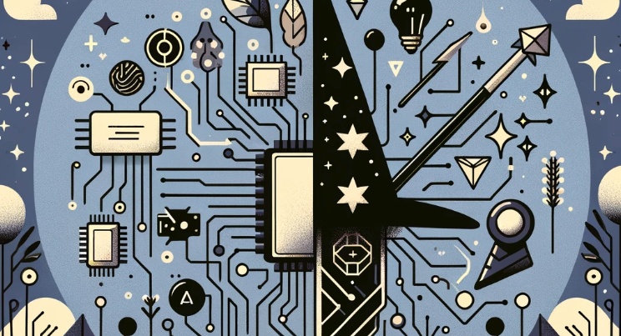
AI != Magic
AI is not new ML was last ‘it thing’ Gen AI new ‘it thing’
Notes:
Today, we're peeling back the layers of AI, not as a sudden marvel but as a rich, evolving journey.
AI's tale begins not in recent years but stretches back to the 20th century, growing from basic symbolic AI to today's sophisticated neural networks.
1952: A computer scientist named Arthur Samuel developed a program to play checkers, which is the first to ever learn the game independently.
1956: John McCarthy held a workshop at Dartmouth on “artificial intelligence” which is the first use of the word, and how it came into popular usage.
Alan Turing, widely known for his contribution to what we now know to be a computer, was one such academic². His paper, “Computing Machinery and Intelligence,” highlighted the logic behind building intelligent machines and how to test their intelligence².
The term “artificial intelligence” was officially coined by John McCarthy, a computer scientist and one of the founding fathers of AI, alongside Alan Turing².
Neural networks were once considered a dead end
A great book for its history is “Artificial Intelligence: A Guide for Thinking Humans” by Melanie Mitchell.
The real game-changer for AI came with machine learning, transforming how computers learn from data, shifting from fixed rules to adaptive, learning systems. This evolution set the groundwork for the AI breakthroughs we see today.

Slide 4
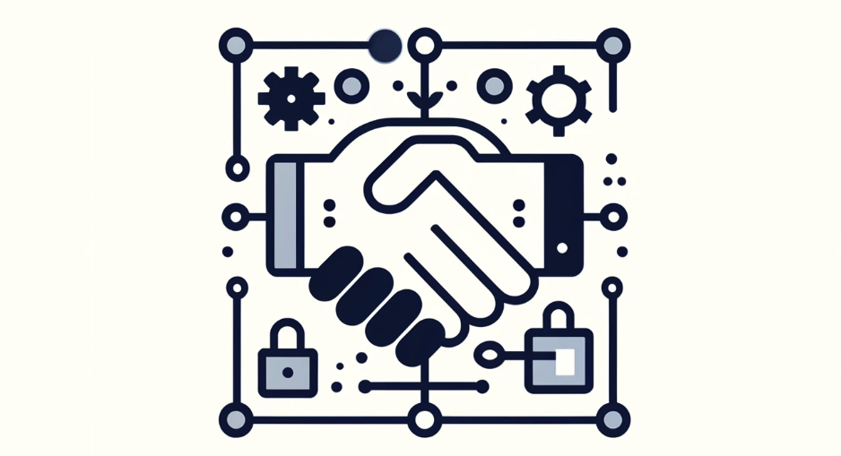
AI == Better, Faster, Strong, and Safer
What is useful?
Does it seamlessly provide utility?
Is it robust enough to approach or match human levels of trust?
Notes:
Now, we stand at the threshold of a new era with Large Language Models and Conversational AI, of which both are reshaping our understanding of machine capabilities.
This isn't just a leap forward but a step built on decades of progress.
As we explore the role of AI in DevOps, we aim for a balance, leveraging AI's transformative power while staying grounded in its true capabilities.
Our journey is about embracing AI's full spectrum, from its historical roots to its future potential.
Let's dive into the world of AI with open minds, ready to appreciate its depth, complexity, and the promise it holds for the future.

Slide 5
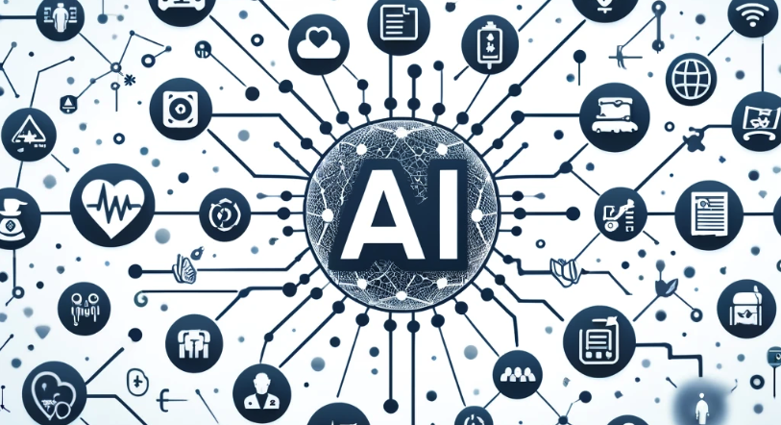
The Broad Impact of AI on Work
AI revolution is not confined to just Tech companies.
Notes:
Let's embark on this journey by first understanding how AI, a technology that's reshaping our daily lives, extends its transformative touch beyond tech industries into various sectors. This broad impact sets the stage for its pivotal role in DevOps. From smart assistants in our homes to sophisticated algorithms predicting consumer behavior, AI's capabilities are changing the way we work and conduct the day-to-day of our lives. This broad impact of AI is a precursor to understanding its specific contributions to DevOps, where it enhances automation, improves decision-making, and fosters innovation.

Slide 6

The Broad Impact of AI on Work
Healthcare
Notes:
<< HIMSS ATTENDANCE>> In the healthcare sector, AI's capabilities to enhance early disease detection and personalize patient care stand out as quintessential examples of its transformative power. AI algorithms, through advanced data analysis, have the ability to parse through medical imaging with a precision that rivals, and sometimes surpasses, human experts. This not only speeds up the diagnostic process but significantly improves the accuracy of early disease detection, which is critical for successful treatment outcomes. Beyond diagnostics, AI in healthcare extends to patient care management, where it personalized treatment plans based on individual patient data, improving the quality of care and patient satisfaction. These examples from healthcare illuminate AI's potential to augment human capabilities, making processes more efficient and outcomes more effective—principles directly applicable to enhancing DevOps practices.

Slide 7
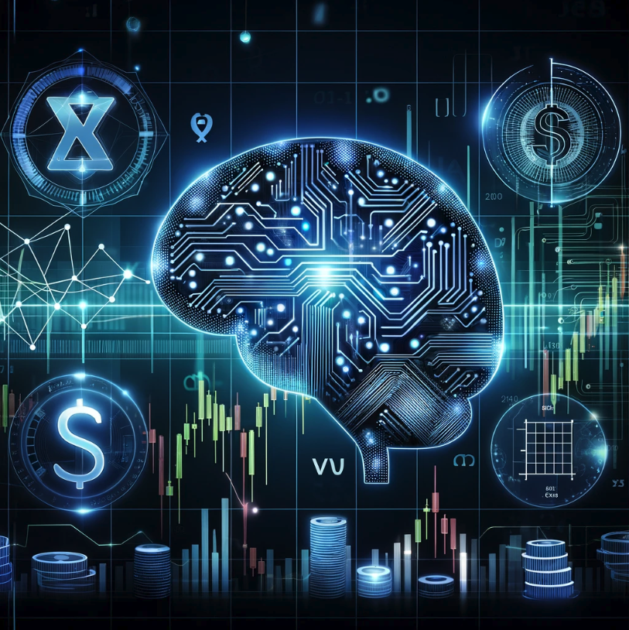
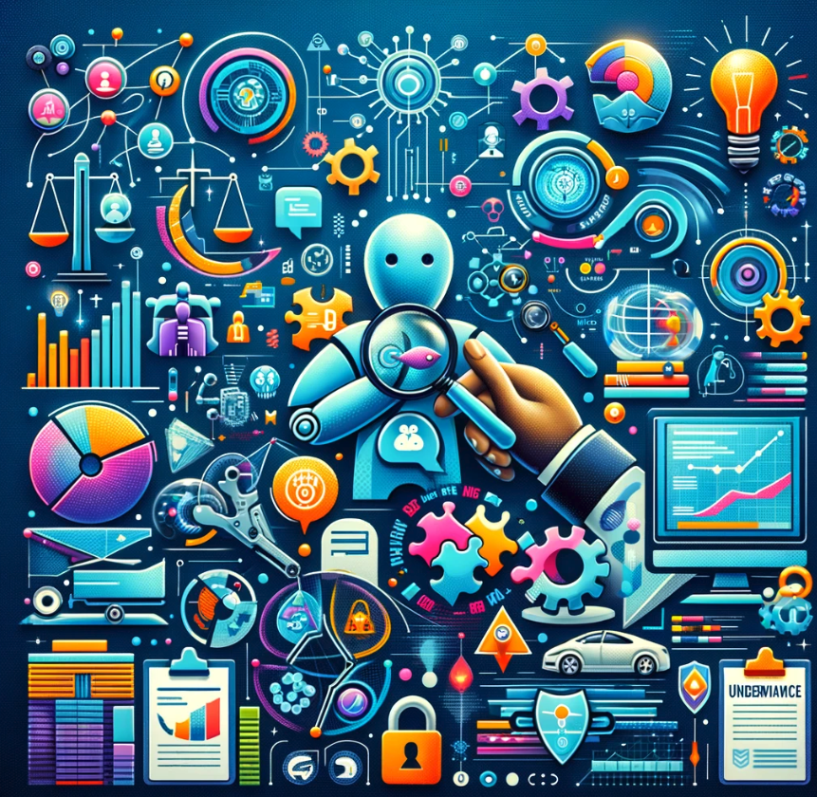
The Broad Impact of AI on Work
Insurance
Notes:
In the insurance industry, AI is revolutionizing how policies are personalized, claims are processed, and fraud is detected. Companies like Lemonade have harnessed AI to assess risk and customize insurance policies with unprecedented accuracy, tailoring coverage to fit individual needs while optimizing pricing. << LEMONADE EXPERIENCE >> Furthermore, AI's role in streamlining the claims process—reducing it from weeks to mere days—exemplifies efficiency and customer satisfaction. Additionally, AI's ability to analyze patterns and detect anomalies plays a crucial role in combating insurance fraud, ensuring fairness and keeping premiums reasonable. These advancements in insurance highlight AI's capacity to transform traditional processes, making them faster, more personalized, and secure—a testament to the potential of AI to similarly transform DevOps practices by enhancing efficiency, security, and user satisfaction.

Slide 8

The Broad Impact of AI on Work
Manufacturing
Notes:
In manufacturing, AI has ushered in a new era of efficiency and predictive maintenance. Consider how AI algorithms predict when machines are likely to fail, allowing for preemptive maintenance, reducing downtime, and saving costs. This precision in predicting and averting failures exemplifies AI's potential to enhance decision-making and operational efficiency. << Machines monitoring Machines Bit >> In DevOps, similar AI applications can predict system vulnerabilities or optimize resource allocation, ensuring our development pipelines are not just faster and more efficient but also more robust and secure. << FOOD PRODUCTION - BLUEBERRY SORTING and CLASSIFICATION >> By learning from AI's impact in manufacturing, we can envision a DevOps environment where predictive insights and efficiency drive us towards excellence.

Slide 9
?
The Broad Impact of AI on Work
Notes:
From healthcare to manufacturing, AI's ability to enhance efficiency and decision-making mirrors its potential in DevOps. The narrative across these sectors reveals a common thread: AI's capacity to enhance precision, efficiency, and foresight. Let's explore how these principles translate into better practices in DevOps as it relates to support, operations, deployment, and beyond. Having seen AI's influence, let's zoom into its integration with DevOps. Here, AI is not just a tool but a catalyst, enriching culture, optimizing operations, and ensuring security, illustrating a new potential for software development and operation making us Better, Faster, Stronger and Safer as it seamlessly integrates into our workflow.

Slide 10

Intersection of AI and DevOps - Culture and Support
PagerDuty Splunk On-Call BigPanda xMatters
Notes:
In the evolving DevOps landscape, AI is playing a pivotal role, especially through the innovative use of chatbots and incident management solutions. These technologies are transforming how teams collaborate, respond to incidents, and manage operations.
Chatbots in platforms like Slack have become invaluable, enabling teams to execute deployment commands for cloud infrastructure on AWS, Azure, or GCP seamlessly. << 8th light example >>
Another example of chatbots is PagerDuty’s Copilot a GenAI solution that helps teams draft PMs to authoring automation jobs, it helps make teams better, faster, stronger and safer by streamlining coordination and enhancing incident learnings to avoid repeats.
Moving to incident management, we also see this transformation in Splunk On-Call, which uses AI for proactive incident prediction and response. Similarly, BigPanda and xMatters enhance real-time performance monitoring and targeted notifications, embedding intelligence into our daily workflows.
These advancements are not just enhancing operational efficiency; they're fostering a culture of rapid innovation and collaboration, allowing us to respond dynamically to challenges.

Slide 11
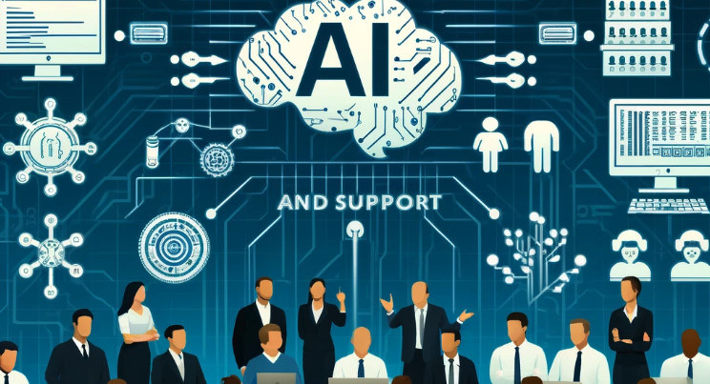
Intersection of AI and DevOps - Culture and Support
Self Service Streamlined Deployment Enhanced Incident Management
Notes:
The impact of AI-enhanced tools in DevOps is significantly changing how teams interact and work more efficiently. With the adoption of tools like Opsgenie, VictorOps, BigPanda, and xMatters, work environments are becoming more integrated and communicative. Really driving home the DevOps philosophy.
These tools facilitate smoother deployments and faster incident responses, enhancing our ability to swiftly adapt to new technologies. With AI at the core, they automate complex processes and ensure that teams can spend more time on innovation rather than routine tasks.
The advantages of integrating these AI tools are substantial. They lay a solid foundation for future challenges and innovations, allowing for increased levels of efficiency and collaboration. This transformation is not just about improving our current methods; it's about reimagining the possibilities of what we can achieve together in DevOps.
By using these AI-powered solutions, we're developing a resilient and forward-looking approach to DevOps that encourages change, supports collaboration, and promotes innovation all while seamlessly integrating into our existing workflows.

Slide 12

Intersection of AI and DevOps - Operations and Deployment
GitLab
Harness Argo CD
CoPilot / Codeium.ai CodeRabbit.ai
Notes:
AI is also altering how CI/CD pipelines and development processes operate, enhancing efficiency and setting new benchmarks for speed and reliability. One such tool leading the transformation is GitLab in using AI to automate processes, improve code quality and enhance security within the CI/CD pipeline.
Shifting the focus to deployment, Harness incorporates AI to revolutionize the way software is delivered. Its AI-driven Continuous Delivery platform automates the verification of deployments using machine learning to analyze deployment metrics, detect anomalies, and predict the success of deployments. This ensures that only stable releases are promoted, enhancing the reliability of production environments.
Argo CD, on the other hand, employs AI in managing Kubernetes deployments. It utilizes predictive analytics to enable smarter rollback strategies and optimize canary deployments. By forecasting deployment outcomes, Argo CD minimizes deployment risks, ensuring that updates are seamlessly rolled out with minimal disruption.
These platforms underscore AI's transformative impact on DevOps, from streamlining CI/CD processes to ensuring robust and reliable deployments. As we delve deeper into these AI-driven enhancements, it's clear that AI is not just augmenting but redefining operations and deployment, paving the way for a new era of intelligent automation and productivity.
Beyond CI/CD optimizations and deployments, AI's influence extends into the very fabric of coding and code management. A tool like CodeRabbit.ai exemplifies this by automating code reviews with AI. It scrutinizes code for potential errors, suggests optimizations, and enforces coding standards, acting as an ever-vigilant reviewer that helps maintain high code quality. By providing real-time feedback and recommendations, CodeRabbit.ai assists developers in improving their code before it even reaches the human review stage, thus attempting to enhancing overall productivity and accelerating the development process. << This is experimental but it could prove promising >>

Slide 13
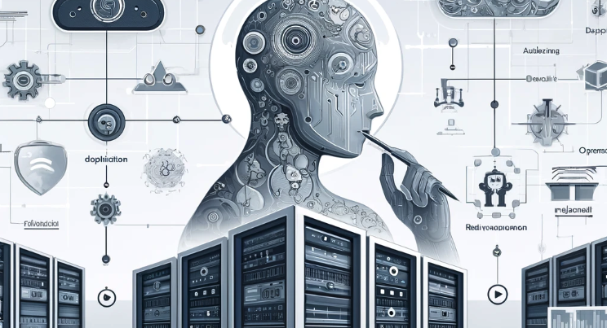
Intersection of AI and DevOps - Operations and Deployment
Predictive Maintenance Cost Saving
Notes:
AI's impact on extends into operational excellence and efficiency, with tech giants leading the charge. Netflix employs AI to optimize its content delivery networks, significantly improving user experience through better content availability and streaming quality. Google leverages AI for predictive maintenance, enabling proactive system repairs and reducing data center downtime, which translates to substantial cost savings and increased reliability.
These instances showcase how AI-driven strategies are essential for operational excellence, offering predictive insights that lead to more efficient, robust, and customer-centric operations. By adopting AI, companies are not only enhancing their software development lifecycles but are also setting new benchmarks for operational performance, marking a new era of innovation powered by intelligent automation.

Slide 14

Intersection of AI and DevOps - Testing and Security
Synk Aqua Security Trivy Checkmarx
Notes:
AI is also having a significant impact on the Testing and Security side of DevOps. Tools like Snyk, Aqua Security Trivy, and Checkmarx stand at the forefront, utilizing AI to transform how we approach security protocols and vulnerability detection.
Snyk harnesses machine learning to sift through dependencies, prioritizing security issues based on their potential impact and seamlessly weaving security into the fabric of the DevOps workflow. This ensures vulnerabilities are addressed promptly, safeguarding applications from the early stages of development.
Aqua Security Trivy employs AI to conduct comprehensive scans across containers and Infrastructure as Code (IaC), significantly bolstering our capability to detect vulnerabilities early on. Its AI-driven approach provides a thorough analysis, enabling more secure container and cloud-native applications.
Checkmarx leverages AI for both static and dynamic analysis, pinpointing security flaws with remarkable precision. By automating the detection of code vulnerabilities, Checkmarx enhances the security posture without impeding the development pace.
This shift towards AI-driven security management marks a new era of proactive and intelligent defense mechanisms, elevating the security and effectiveness of our systems against evolving threats. Some of which include AI!

Slide 15
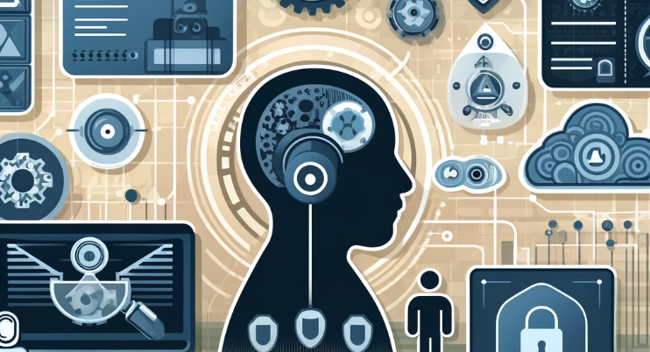
Intersection of AI and DevOps - Testing and Security
No Longer a Luxury Testing Code Enhanced Security Posture
Increased Vulnerability Detection
Notes:
It's clear that AI's contribution to DevOps transcends mere task automation. AI acts as a force, rejuvenating every aspect of the workflow, including operations, deployment, testing, and security. It empowers organizations to not only respond swiftly changes but also to anticipate and strategize for the challenges ahead, thereby converting reactive measures into proactive strategies.
The advantages of integrating AI into Testing and Security are manifold: we see a notable increase in operational efficiency, a bolstered security posture, and an acceleration in innovation cycles. As AI continues to evolve, we can expect even deeper integration into DevSecOps and Testing, heralding the advent of more sophisticated, resilient, and efficient systems.
Ultimately, AI doesn’t just tweak our existing processes; it enriches them in unobtrusive ways making them Better, Faster, Strong and Safer resulting in more product delivery.

Slide 16
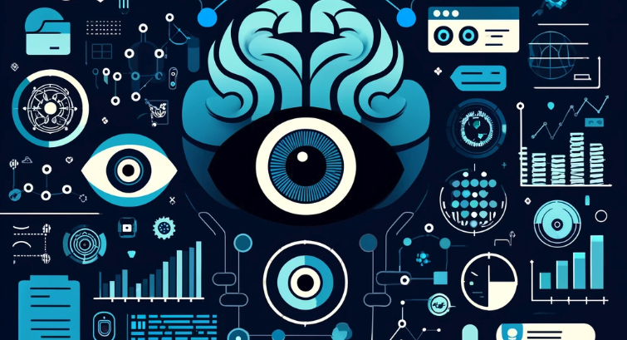
Intersection of AI and DevOps - Monitoring and Anomaly Detection
Datadog
Splunk Elasticsearch New Relic Dynatrace
Notes:
Rounding out this deep dive, we delve into the impact of AI on monitoring and anomaly detection. Tools like Datadog, New Relic, and Splunk are leading the charge, utilizing AI to offer comprehensive monitoring across applications, networks, and infrastructure. These platforms excel at detecting anomalies and foreseeing issues before they arise.
Datadog employs machine learning algorithms for anomaly detection, allowing DevOps teams to spot unusual behavior across their stack swiftly. New Relic provides AI-powered incident intelligence, reducing noise and focusing on the problems that matter most. Splunk uses AI and machine learning for predictive analytics, helping predict and prevent service disruptions before they impact users.
Expanding our toolkit, Elasticsearch leverages AI for log and performance data analysis, enhancing the observability of distributed systems. Similarly, Dynatrace applies AI for automatic root cause analysis, making it easier for teams to pinpoint the origins of issues across increasingly complex environments.
These AI-driven platforms transform how we approach monitoring and anomaly detection, moving from reactive to proactive issue resolution.

Slide 17
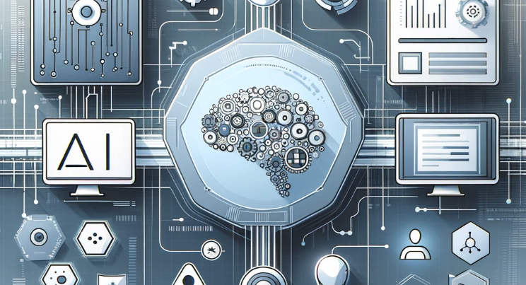
Intersection of AI and DevOps - Monitoring and Anomaly Detection
Predictive Monitoring
Cost Savings Enhanced System Reliability
Notes:
As we summarize our journey through the realm of monitoring and anomaly detection, the transformative potential of AI within DevOps becomes unmistakably clear. The advanced capabilities of AI for predictive insights and real-time anomaly detection mark a pivotal shift towards more intelligent, resilient, and efficient operations.
The AI-powered analytics offered by platforms like Datadog, New Relic, Splunk, Elasticsearch, and Dynatrace illustrate this shift, enabling DevOps teams to proactively manage system health and prevent downtime. These tools exemplify how AI is reshaping the monitoring landscape, empowering teams with the ability to address issues before they affect users, minimizing downtime, and optimizing performance.

Slide 18
?
Navigating the Future
Notes:
As AI becomes more integral to our software systems, the need for specialized operational frameworks like ML Ops and LLM Ops grows increasingly important. These disciplines are essential for several key reasons: Complexity Management, Scalability, Governance and Compliance and Continuous Model Improvement of AI features. This evolution reflects the growing expectation for software to inherently include AI features.
As these technologies become more embedded in the tools we use daily, they're not just optional extras but essential components that drive efficiency, innovation, and resilience in our operations along with the platforms and systems we operate.
These emerging fields offer a focused lens on managing the complexities of machine learning and large language models, signaling a future where AI's role in DevOps is not just to augment but to create new operational paradigms.

Slide 19
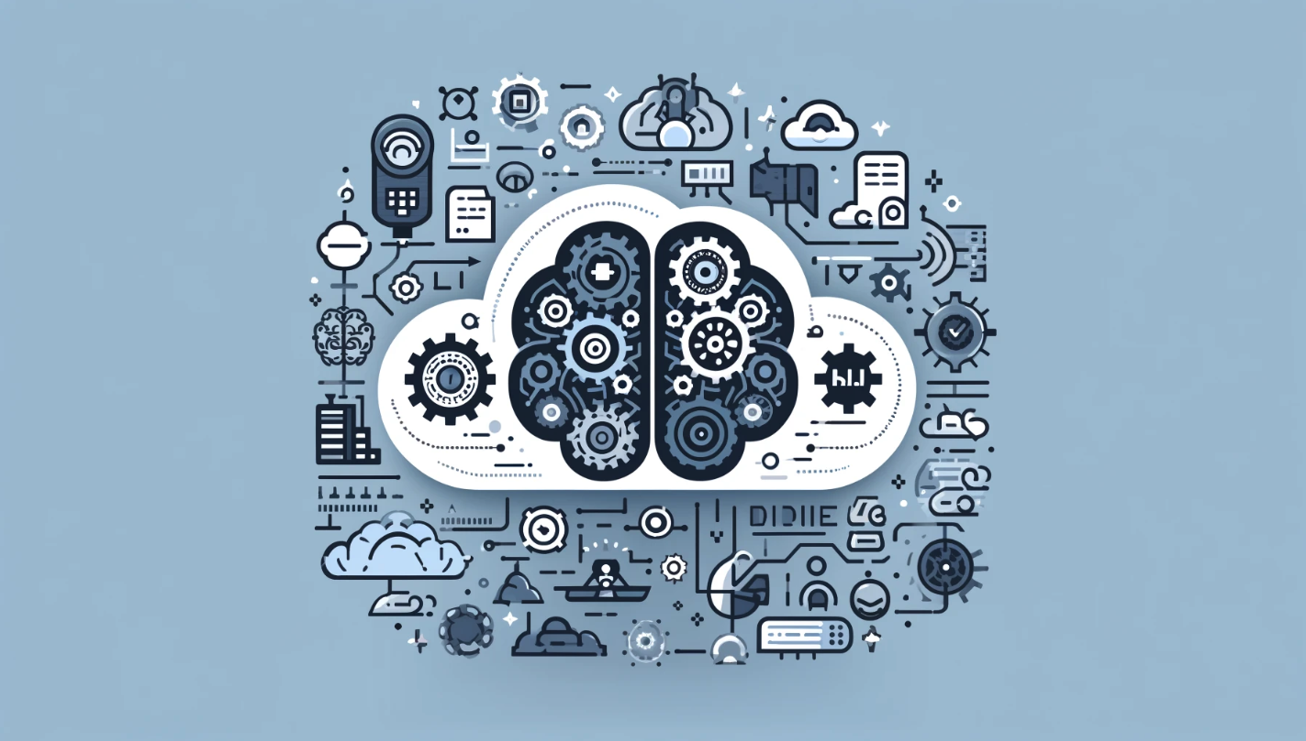
Navigating the Future - MLOps
arize.com remyx.ai
mlflow.org
comet.ml
Data Version Control - dvc.org
Kubeflow
Notes:
Building on our understanding of AI's role in DevOps, we enter the realm of ML Ops. This discipline highlights a commitment to automation, version control, and continuous improvement, crucial for the development of ML-powered applications. In the crossroads of MLOps, we find the integration of machine learning with DevOps practices, propelling the development of ML-powered applications towards excellence. As we explore the landscape shaped by platforms like Arize, Remyx.ai, MLflow, Comet.ml, DVC, and Kubeflow, we uncover the essential pillars that elevate MLOps from a mere methodology to a transformative force in software delivery.
The Core Pillars of MLOps:
Version Control: Vital for managing both models and datasets, ensuring every aspect of our projects is traceable and manageable.
Continuous Integration and Delivery (CI/CD) for ML: Facilitates the automation of the ML lifecycle, from data preparation through to model deployment, ensuring a seamless, efficient journey for each model.
Automated Testing: Encompasses everything from data validation to model performance checks, guaranteeing models behave as expected across all stages.
Monitoring and Validation: Employs continuous oversight of model performance to swiftly pinpoint and rectify any issues like model drift or data discrepancies.
Implementing MLOps Means:
Integrating ML operations within CI/CD pipelines for the automated deployment of precise, real-time models.
Prioritizing reproducibility by meticulously tracking experiments, versions, and datasets.
Utilizing advanced monitoring tools, such as those provided by Arize and Comet.ml, not merely to observe but to anticipate and preemptively address potential issues, ensuring the integrity and reliability of models in production.
Platforms like Remyx.ai simplify the deployment and management of ML models, making sophisticated ML operations accessible. MLflow and DVC support the comprehensive management of the ML development process, from experimentation to deployment, with a focus on reproducibility and collaboration. Kubeflow extends these capabilities to Kubernetes, offering a scalable and portable solution for deploying machine learning workflows.
As we integrate these platforms and principles into our DevOps workflows, we establish a strong foundation for our machine learning projects, ensuring scalability, reproducibility, and seamless integration. This approach through MLOps speeds up the adoption of ML/AI in our software systems and helps deliver smart, reliable software more quickly.

Slide 20

Navigating the Future - MLOps
Model Evaluation Metric
Drift Metrics
Model Fairness
Model Deployment
Notes:
Reflecting on our exploration of MLOps, it’s evident that as we delve deeper into AI and machine learning, MLOps is not merely about deploying models but fostering a culture of excellence and innovation that aligns with the DevOps philosophy.
Looking Ahead: Trends and Considerations
AI Ethics and Governance: As AI becomes more prevalent, embedding ethical considerations and governance in MLOps practices is crucial.
Hybrid and Multi-Cloud Strategies: The flexibility to deploy and manage models across various cloud environments enhances resilience and scalability.
Edge Computing: Deploying models closer to the data source reduces latency, opening new avenues for real-time applications.
AutoML and ModelOps: The rise of automated machine learning and dedicated ModelOps emphasizes the move towards more efficient, self-optimizing models and operations.
As MLOps continues to evolve, staying abreast of these trends will be key to leveraging AI effectively. The integration of MLOps into DevOps is not just advantageous but necessary for the development and deployment of AI-driven solutions.

Slide 21

Navigating the Future - LLMOps
freeplay.ai arize.com
LangChain Weights & Biases - wandb.ai LabelBox Kili Technology
Notes:
With a grasp on ML Ops, our journey leads us to LLMOps, where the sophistication of managing Large Language Models comes to the fore. Here, prompt engineering and observability tools play critical roles in accommodating the use of LLMs effectively.
In the advancing field of Large Language Models (LLMs), LLMOps emerges as the essential framework. It encapsulates the deep integration of prompt engineering, observability and monitoring tools in deploying the use of LLMs effectively.
At the Heart of LLMOps: Prompt Engineering and LLM Agents The journey into LLMOps is headed up by the use of prompt engineering, a technique that enables us to craft queries that elicit accurate responses from LLMs. Employing strategies such as few-shot and chain of thought prompting significantly enhances LLM performance, making prompt engineering a cornerstone of LLM optimization. One of the key worries here is Hallucination detection and ensuring that the LLM responds in a business friendly manner and if not corrective action can be taken.
Architectures like LangChain facilitate complex interactions, allowing us to create applications that are not only scalable but also highly responsive. This complexity underscores the importance of a strategic approach to LLMOps that goes beyond deployment, focusing on the continuous refinement and enhancement of models through real-time feedback and advanced observability.
Observability in LLMOps: A Pillar of Effective Management The observability of LLMs, as outlined by the Arize framework, introduces five critical pillars to effectively manage the lifecycle of LLM applications:
LLM Evaluation: Assessing response quality against various prompts.
Traces and Spans: Isolating issues within complex agentic workflows.
Prompt Engineering: Refining inputs for efficiency and cost-effectiveness.
Search and Retrieval: Enhancing prompt relevance with superior information retrieval techniques.
Fine-Tuning: Aligning models more closely with specific use conditions or domains.
Empowering LLMOps with Specialized Tools To navigate these pillars successfully, we rely on a ecosystem of tools:
Freeplay.ai excels in managing and optimizing prompts, ensuring cost-effective and efficient LLM performance.
Arize AI and Weights & Biases provide deep insights into model behavior and performance metrics, key for monitoring trends and anomalies.
For fine-tuning and data annotation, Kili, Label Studio, and LabelBox offer robust platforms for annotating datasets, crucial for precise model training and improvement.
Integrating these tools within your LLMOps strategies ensures that our LLM applications are not only deployed but also continuously adapted and refined.
By embracing this comprehensive approach to LLMOps, we set new standards for AI-driven solutions, marked by innovation, efficiency, and a commitment to excellence. LLMOps is not just a practice but a transformational force, readying us for the future of AI interaction.

Slide 22

Navigating the Future - LLMOps
Prompt Engineering and Management
Fine Tuning
Build vs Buy vs Open Source LLM Hallucination Detection Context Retrieval
Notes:
Our journey through LLMOps showcases a path with new discoveries, teamwork, and ongoing growth. By enhancing our approach to crafting prompts and utilizing LLMs, we're making big strides in developing smarter, more aware applications.
This process is crucial for keeping our AI enriched systems running smoothly and making sure they truly understand and respond to what users need. A big part of this effort involves observability—keeping a close eye on how well our LLMs are performing and how they're interacting with users. This careful monitoring helps us fine-tune our models for better accuracy and relevance.
While challenges lie ahead, LLMOps prepares us to explore the full potential of LLMs, pushing the boundaries of what we can achieve with technology.

Slide 23

Notes:
As we wrap up, it’s clear we’re at an exciting point where AI meets DevOps, changing how we work and operate software. We’ve looked at how AI makes DevOps better, from working together smoother to solving problems faster.. We also touched on ML Ops and LLMOps, showing us new ways to handle complexities of including AI in a system or platform.
Looking ahead, I see a world full of new chances and challenges all in the interest of making us Better, Faster, Strong and Safer.
In summary the trends Ai will bring to DevOps are
No longer optional, need AI to fight AI’s new vectors enhancing DevSecOps
ML to see a resurgence of interset to augment Gen AI
Gen AI to help streamline and optomize DevOps, ML Ops and LLM Ops
More deligating to a platform / collection of tools to continue gaining momentum
Better collaboration and fater learing loops resulting in better overall product delivery and operation
Now, it’s your turn. Use what you’ve learned today to do not just make your job easier but to make a difference, to do things that matter.

Slide 24

https://linktr.ee/tmfrisinger
Notes:
Thank you for joining me on this journey.

Slide 25
https://cloud.folio3.com/blog/generative-ai-in-devops/
https://about.gitlab.com/topics/devops/the-role-of-ai-in-devops/
https://devops.com/how-ai-addresses-devops-monitoring-and-observability-challenges/
https://devops.com/logz-io-leverages-ai-to-identify-anomalies-in-real-time/
https://www.techtarget.com/searchitoperations/tip/Generative-AI-use-cases-for-DevOps-and-IT
https://clickup.com/blog/ai-tools-for-devops/
https://www.xenonstack.com/insights/ai-in-devops
https://about.gitlab.com/blog/2024/01/17/as-ai-becomes-standard-watch-for-these-4-devsecops-trends/
https://www.techtarget.com/searchitoperations/tip/Generative-AI-use-cases-for-DevOps-and-IT
https://docs.arize.com/arize/what-is-ml-observability
https://devops.com/how-ai-transforms-devops-infrastructure/
https://devops.com/revolutionizing-the-nine-pillars-of-devops-with-ai-engineered-tools/
https://freeplay.ai/blog/building-products-with-llms-lessons-learned-from-industry-leaders
https://ml-ops.org/content/mlops-principles
https://www.databricks.com/glossary/llmops
https://www.ibm.com/topics/llmops
https://arize.com/blog-course/llmops-operationalizing-llms-at-scale/
Sources

